Slide 1

Deep Learning-Driven Public Complaint Categorization and Urgency Detection Framework
MLA0408 - Deep Learning
Faculty DR.D.SUDHAGAR
Dept. of CSE
SIMATS Engineering
J.RAJU(192325117)
K. Hema Sai Siddartha(192325036)
M.MEGHANADH(192325026)
K.NAGESH REDDY(192325083)
SIMATS Engineering

Slide 2



INTRODUCTION
In the era of digital governance, citizens frequently submit complaints through online portals, mobile applications, and social media platforms. These complaints address issues related to civic infrastructure, public utilities, safety, and government services. However, most public grievance redressal systems rely heavily on manual processing, where officials read and categorize each complaint individually.
Automatically categorizing complaint text
Detecting urgency levels
Identifying critical public safety concerns
Assisting authorities in prioritizing responses

Slide 3
PROBLEM STATEMENT
Complaints are reviewed and categorized manually
No automatic urgency detection mechanism
Increased response time and reduced efficiency
AI-powered automated complaint classification
Deep Learning model for urgency prediction (High / Medium / Low)
Improved accuracy and reduced manual workload

Slide 4


OBJECTIVES
Develop automated complaint classification model
Detect urgency levels (High / Medium / Low)
Build web-based complaint management system
Improve governance efficiency & response time

Slide 5
LITERATURE REVIEW
Year | Title of the Paper | Objectives | Limitations
2021 | NLP-Based Public Grievance Classification System | To classify public complaints into predefined categories using traditional machine learning techniques. | Limited accuracy due to manual feature engineering and inability to capture deep contextual meaning.
2022 | Deep Learning Approach for Text Classification in E-Governance | To apply deep learning models for automatic classification of citizen complaints. | Focused only on categorization; did not address urgency prediction.
2023 | Sentiment Analysis for Public Service Feedback | To analyze citizen sentiment and determine positive or negative feedback trends. | Sentiment analysis does not effectively identify urgency or emergency situations.
2024 | Transformer-Based Complaint Routing System | To use transformer models for routing complaints to appropriate departments automatically. | High computational cost and requires large labeled datasets.
2025 | Intelligent Complaint Prioritization Using AI | To predict priority levels of complaints using machine learning algorithms. | Limited performance with unstructured and noisy text data; scalability issues in real-time deployment.

Slide 6
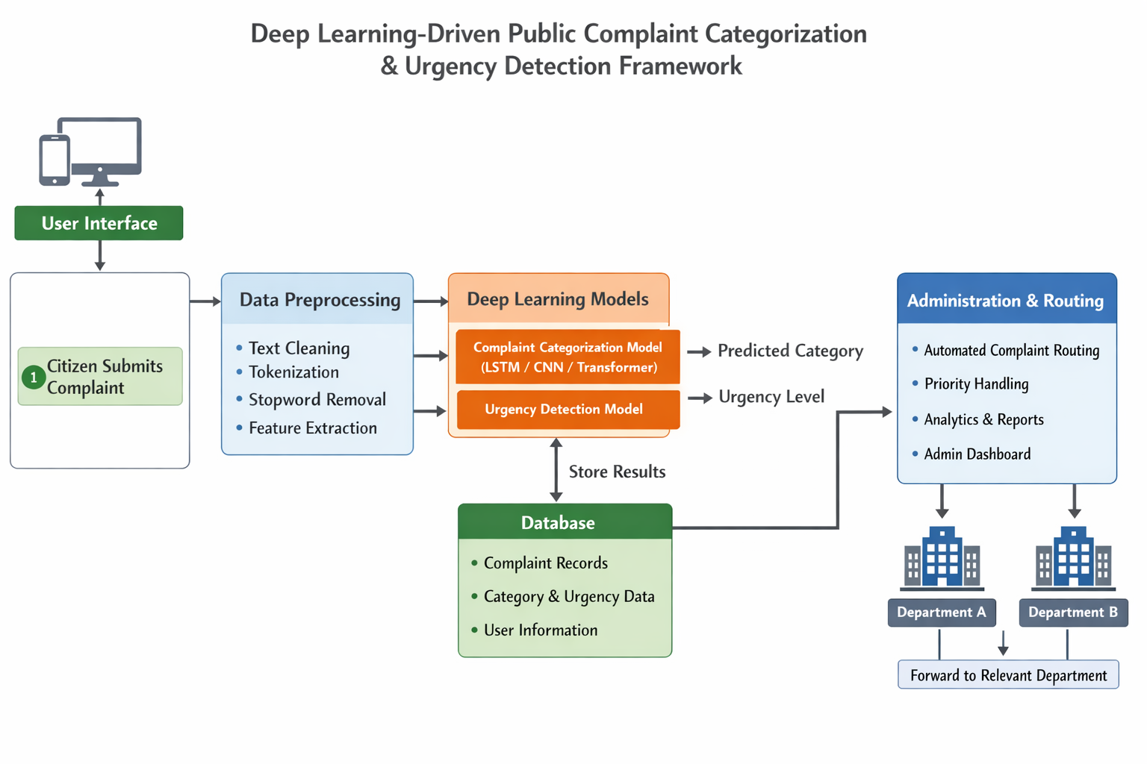
SYSTEM ARCHITECTURE

Slide 7
Module 1: Complaint Data Collection and Preprocessing
Collect public complaints from various sources such as government portals, social media platforms, emails, and mobile applications.
Clean the collected data by removing duplicate records, missing values, unwanted symbols, and irrelevant information.
Perform text preprocessing techniques including tokenization, stop-word removal, stemming, and lemmatization.
Convert complaint text into meaningful numerical representations using feature extraction methods such as TF-IDF, Word2Vec, or BERT embeddings.
Prepare a structured dataset that can be used for training and testing deep learning models.

Slide 8
Module 2: Deep Learning-Based Complaint Categorization
Develop a deep learning model to automatically classify complaints into categories such as Water Supply, Electricity, Roads, Sanitation, Healthcare, and Transportation.
Train the model using preprocessed complaint data and labeled categories.
Extract semantic and contextual information from complaint text using NLP and deep learning techniques.
Predict the appropriate complaint category for newly submitted complaints.
Evaluate model performance using metrics such as Accuracy, Precision, Recall, and F1-Score to ensure reliable classification.

Slide 9
Module 3: Urgency Detection and Complaint Prioritization
Design a deep learning model to determine the urgency level of complaints based on their content and severity.
Classify complaints into urgency levels such as Low, Medium, High, and Critical.
Generate priority scores to help authorities identify and address important complaints first.
Provide real-time analysis and alerts for highly urgent complaints requiring immediate attention.
Display complaint categories, urgency levels, confidence scores, and complaint statistics through an interactive dashboard for efficient monitoring and decision-making.

Slide 10
Module 4: Complaint Resolution, Monitoring and Feedback
Complaint Assignment and Routing: Automatically assign categorized complaints to the appropriate department or authority.
Resolution Tracking: Monitor complaint status from registration to final resolution.
Response Recommendation: Generate suitable response suggestions using AI based on complaint category and urgency.
Performance Monitoring: Analyze resolution time, pending complaints, and department-wise performance.

Slide 11
CHALLENGES & LIMITATIONS
The system requires a sufficient amount of labeled complaint data for accurate training and classification.
Complaint categorization accuracy may be affected by ambiguous or incomplete complaint descriptions.
Urgency detection performance depends on the quality and diversity of training data.
System performance may decrease when handling large volumes of complaints simultaneously.
Regular model updates and maintenance are required to ensure accuracy and adaptability.

Slide 12
FUTURE SCOPE
A mobile application can be developed for easier complaint submission and tracking.
Complaint categorization accuracy can be improved using more advanced deep learning models.
Multilingual support can be added to handle complaints in different regional languages.
Cloud-based infrastructure can be expanded to manage large volumes of complaints efficiently.
The system can be integrated with government grievance management platforms.
Real-time notifications can be sent to citizens and authorities regarding complaint status updates.
Data analytics can be used to identify complaint trends and support better decision-making.

Slide 13



CONCLUSION
The Deep Learning-Driven Public Complaint Categorization and Urgency Detection Framework automates the classification of public complaints and identifies their urgency levels, reducing manual effort and improving response efficiency.
Deep learning algorithms are used to categorize public complaints and detect their urgency, ensuring accurate classification and efficient prioritization of critical issues.
The intelligent dashboard converts complaint data into meaningful insights and reports, helping authorities monitor complaint trends, prioritize urgent issues, and make better decisions.

Slide 14



